Slide 1
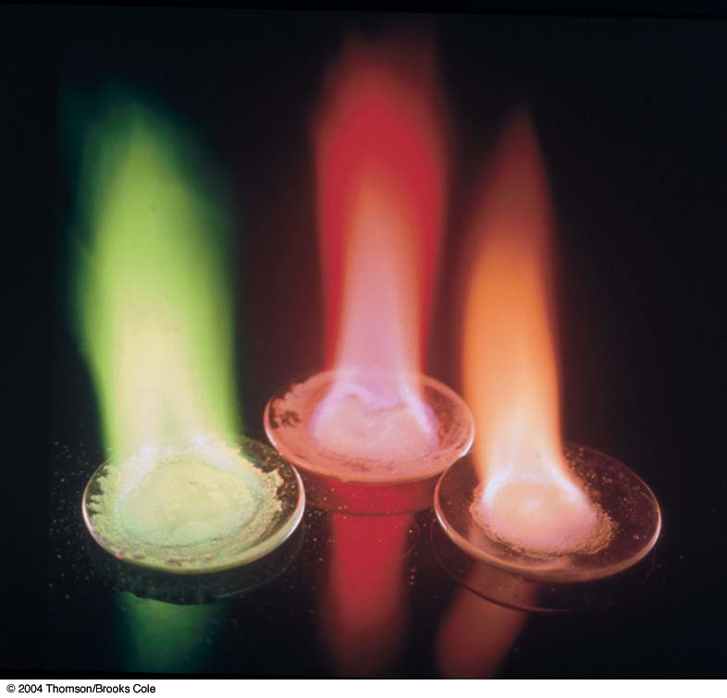
CHAPTER 5
The Structure of Atoms

Slide 2
Chapter Outline
Subatomic Particles
Fundamental Particles
The Discovery of Electrons
Canal Rays and Protons
Rutherford and the Nuclear Atom
Atomic Number
Neutrons
Mass Number and Isotopes
Mass spectrometry and Isotopic Abundance

Slide 3
Chapter Goals
The Atomic Weight Scale and Atomic Weights
The Electronic Structures of Atoms
Electromagnetic radiation
The Photoelectric Effect
Atomic Spectra and the Bohr Atom
The Wave Nature of the Electron
The Quantum Mechanical Picture of the Atom

Slide 4
Chapter Goals
Quantum Numbers
Atomic Orbitals
Electron Configurations
Paramagnetism and Diamagnetism
The Periodic Table and Electron Configurations

Slide 5
Fundamental Particles
Three fundamental particles make up atoms. The following table lists these particles together with their masses and their charges.

Slide 6
The Discovery of Electrons
Humphrey Davy in the early 1800’s passed electricity through compounds and noted:
  that the compounds decomposed into elements.
  Concluded that compounds are held together by electrical forces.
Michael Faraday in 1832-1833 realized that the amount of reaction that occurs during electrolysis is proportional to the electrical current passed through the compounds.

Slide 7
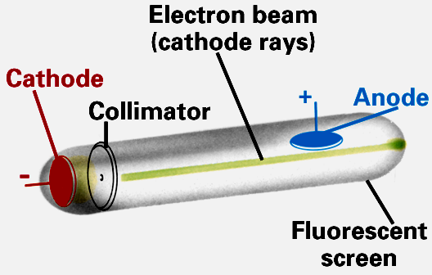
The Discovery of Electrons
Cathode Ray Tubes experiments performed in the late 1800’s & early 1900’s.
  Consist of two electrodes sealed in a glass tube containing a gas at very low pressure.
  When a voltage is applied to the cathodes a glow discharge is emitted.

Slide 8
The Discovery of Electrons
These “rays” are emitted from cathode (- end) and travel to anode (+ end).
  Cathode Rays must be negatively charged!
J.J. Thomson modified the cathode ray tube experiments in 1897 by adding two adjustable voltage electrodes.
  Studied the amount that the cathode ray beam was deflected by additional electric field.

Slide 9
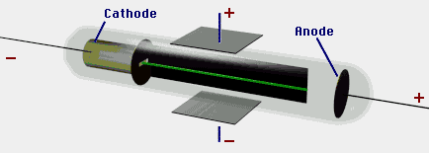
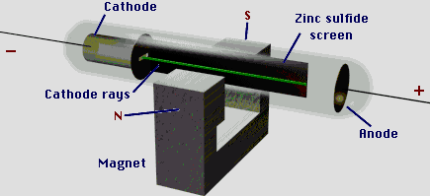

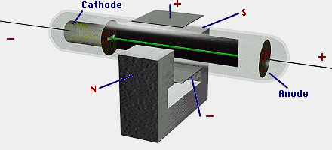
The Discovery of Electrons
Modifications to the basic cathode ray tube experiment.

Slide 10
The Discovery of Electrons
Thomson used his modification to measure the charge to mass ratio of electrons.
  Charge to mass ratio
  e/m = -1.75881 x 10⁸ coulomb/g of e⁻
Thomson named the cathode rays electrons.
Thomson is considered to be the “discoverer of electrons”.
TV sets and computer screens are cathode ray tubes.

Slide 11
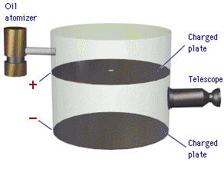
The Discovery of Electrons
Robert A. Millikan won the 1st American Nobel Prize in 1923 for his famous oil-drop experiment.
In 1909 Millikan determined the charge and mass of the electron.

Slide 12
The Discovery of Electrons
Millikan determined that the charge on a single electron = -1.60218 x 10⁻¹⁹ coulomb.
Using Thomson’s charge to mass ratio we get that the mass of one electron is 9.11 x 10⁻²⁸ g.
  e/m = -1.75881 x 10⁸ coulomb
  e = -1.60218 x 10⁻¹⁹ coulomb
  Thus m = 9.10940 x 10⁻²⁸ g

Slide 13
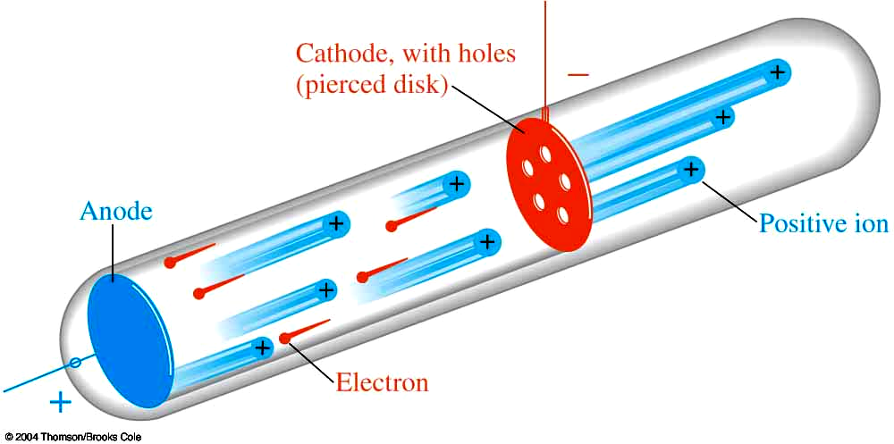
Canal Rays and Protons
Eugene Goldstein noted streams of positively charged particles in cathode rays in 1886.
  Particles move in opposite direction of cathode rays.
  Called “Canal Rays” because they passed through holes (channels or canals) drilled through the negative electrode.
Canal rays must be positive.
  Goldstein postulated the existence of a positive fundamental particle called the “proton”.

Slide 14
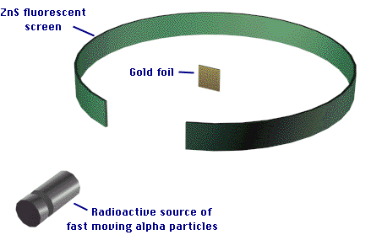
Rutherford and the Nuclear Atom
Ernest Rutherford directed Hans Geiger and Ernst Marsden’s experiment in 1910.
  α- particle scattering from thin Au foils
  Gave us the basic picture of the atom’s structure.

Slide 15
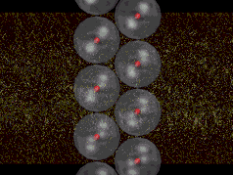
Rutherford and the Nuclear Atom
In 1912 Rutherford decoded the α-particle scattering information.
  Explanation involved a nuclear atom with electrons surrounding the nucleus .

Slide 16
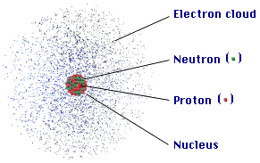
Rutherford and the Nuclear Atom
Rutherford’s major conclusions from the α-particle scattering experiment
  The atom is mostly empty space.
  It contains a very small, dense center called the nucleus.
  Nearly all of the atom’s mass is in the nucleus.
  The nuclear diameter is 1/10,000 to 1/100,000 times less than atom’s radius.

Slide 17
Rutherford and the Nuclear Atom
Because the atom’s mass is contained in such a small volume:
  The nuclear density is 10¹⁵g/mL.
  This is equivalent to 3.72 x 10⁹ tons/in³.
  Density inside the nucleus is almost the same as a neutron star’s density.

Slide 18
Atomic Number
The atomic number is equal to the number of protons in the nucleus.
  Sometimes given the symbol Z.
  On the periodic chart Z is the uppermost number in each element’s box.
In 1913 H.G.J. Moseley realized that the atomic number determines the element .
  The elements differ from each other by the number of protons in the nucleus.
  The number of electrons in a neutral atom is also equal to the atomic number.

Slide 19
Neutrons
James Chadwick in 1932 analyzed the results of α-particle scattering on thin Be films.
Chadwick recognized existence of massive neutral particles which he called neutrons.
  Chadwick discovered the neutron.

Slide 20
Mass Number and Isotopes
Mass number is given the symbol A.
A is the sum of the number of protons and neutrons.
  Z = proton number N = neutron number
  A = Z + N
A common symbolism used to show mass and proton numbers is
Can be shortened to this symbolism.

Slide 21
Mass Number and Isotopes
Isotopes are atoms of the same element but with different neutron numbers.
  Isotopes have different masses and A values but are the same element.
One example of an isotopic series is the hydrogen isotopes.
  ¹H or protium is the most common hydrogen isotope.
    one proton and no neutrons
  ²H or deuterium is the second most abundant hydrogen isotope.
    one proton and one neutron
  ³H or tritium is a radioactive hydrogen isotope.
    one proton and two neutrons

Slide 22
Mass Number and Isotopes
The stable oxygen isotopes provide another example.
¹⁶O is the most abundant stable O isotope.
  How many protons and neutrons are in ¹⁶O?
¹⁷O is the least abundant stable O isotope.
  How many protons and neutrons are in ¹⁷O?
¹⁸O is the second most abundant stable O isotope.
  How many protons and neutrons in ¹⁸O?

Slide 23
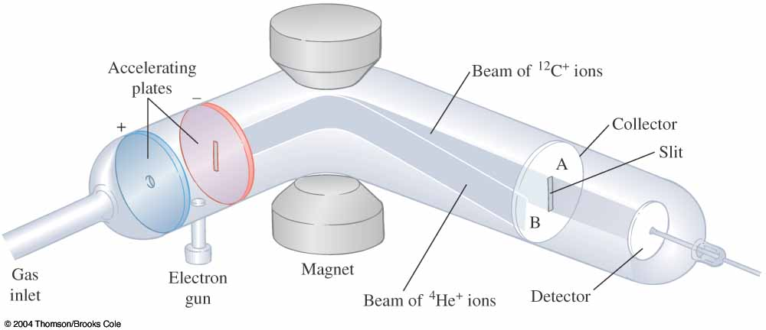
Mass Spectrometry and
Isotopic Abundances
Francis Aston devised the first mass spectrometer.
  Device generates ions that pass down an evacuated path inside a magnet.
  Ions are separated based on their mass.

Slide 24
Mass Spectrometry and
Isotopic Abundances
There are four factors which determine a particle’s path in the mass spectrometer.
  accelerating voltage
  magnetic field strength
  masses of particles
  charge on particles

Slide 25
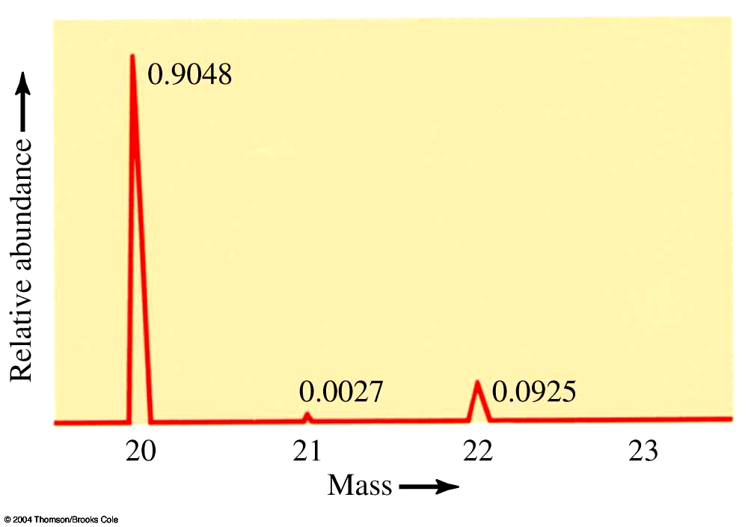
Mass Spectrometry and
Isotopic Abundances
Mass spectrum of Ne⁺ ions shown below.
  How scientists determine the masses and abundances of the isotopes of an element.

Slide 26
The Atomic Weight Scale and Atomic Weights
If we define the mass of ¹²C as exactly 12 atomic mass units (amu), then it is possible to establish a relative weight scale for atoms.
  1 amu = (1/12) mass of ¹²C by definition
  What is the mass of an amu in grams?
Example 5-1: Calculate the number of atomic mass units in one gram.
  The mass of one ³¹P atom has been experimentally determined to be 30.99376 amu.
  1 mol of ³¹P atoms has a mass of 30.99376 g.

Slide 27
The Atomic Weight Scale and Atomic Weights

Slide 28
The Atomic Weight Scale and Atomic Weights
  Thus 1.00 g = 6.022 x 10²³ amu.
  This is always true and provides the conversion factor between grams and amu.

Slide 29
The Atomic Weight Scale and Atomic Weights
The atomic weight of an element is the weighted average of the masses of its stable isotopes
Example 5-2: Naturally occurring Cu consists of 2 isotopes. It is 69.1% ⁶³Cu with a mass of 62.9 amu, and 30.9% ⁶⁵Cu, which has a mass of 64.9 amu. Calculate the atomic weight of Cu to one decimal place.

Slide 30
The Atomic Weight Scale and Atomic Weights

Slide 31
The Atomic Weight Scale and Atomic Weights

Slide 32
The Atomic Weight Scale and Atomic Weights

Slide 33
The Atomic Weight Scale and Atomic Weights
Example 5-3: Naturally occurring chromium consists of four isotopes. It is 4.31% ₂₄⁵⁰Cr, mass = 49.946 amu, 83.76% ₂₄⁵²Cr, mass = 51.941 amu, 9.55% ₂₄⁵³Cr, mass = 52.941 amu, and 2.38% ₂₄⁵⁴Cr, mass = 53.939 amu. Calculate the atomic weight of chromium.
You do it!

Slide 34
The Atomic Weight Scale and Atomic Weights

Slide 35
The Atomic Weight Scale and Atomic Weights
Example 5-4: The atomic weight of boron is 10.811 amu. The masses of the two naturally occurring isotopes ₅¹⁰B and ₅¹¹B, are 10.013 and 11.009 amu, respectively. Calculate the fraction and percentage of each isotope.
You do it!
This problem requires a little algebra.
  A hint for this problem is x + (1-x) = 1

Slide 36
The Atomic Weight Scale and Atomic Weights

Slide 37
The Atomic Weight Scale and Atomic Weights
Note that because x is the multiplier for the ¹⁰B isotope, our solution gives us the fraction of natural B that is ¹⁰B.
Fraction of ¹⁰B = 0.199 and % abundance of ¹⁰B = 19.9%.
The multiplier for ¹¹B is (1-x) thus the fraction of ¹¹B is 1-0.199 = 0.811 and the % abundance of ¹¹B is 81.1%.

Slide 38
The Electronic Structures of Atoms
Electromagnetic Radiation
The wavelength of electromagnetic radiation has the symbol λ .
Wavelength is the distance from the top (crest) of one wave to the top of the next wave.
  Measured in units of distance such as m,cm, Å.
  1 Å = 1 x 10⁻¹⁰ m = 1 x 10⁻⁸ cm
The frequency of electromagnetic radiation has the symbol υ.
Frequency is the number of crests or troughs that pass a given point per second.
  Measured in units of 1/time - s⁻¹

Slide 39
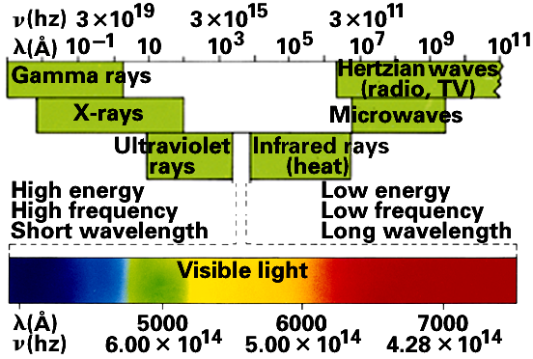
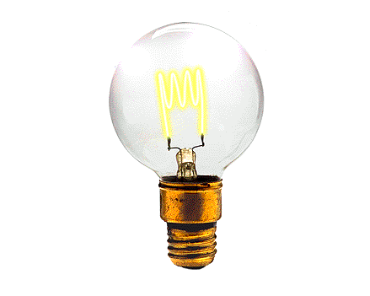
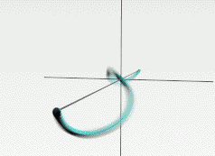
Electromagnetic Radiation
The relationship between wavelength and frequency for any wave is velocity = λ υ.
For electromagnetic radiation the velocity is 3.00 x 10⁸ m/s and has the symbol c.
Thus c = λ υ for electromagnetic radiation.

Slide 40
Electromagnetic Radiation
Molecules interact with electromagnetic radiation.
  Molecules can absorb and emit light.
Once a molecule has absorbed light (energy), the molecule can:
  Rotate
  Translate
  Vibrate
  Electronic transition

Slide 41
Electromagnetic Radiation
For water:
  Rotations occur in the microwave portion of spectrum.
  Vibrations occur in the infrared portion of spectrum.
  Translation occurs across the spectrum.
  Electronic transitions occur in the ultraviolet portion of spectrum.

Slide 42
Electromagnetic Radiation
Example 5-5: What is the frequency of green light of wavelength 5200 Å?

Slide 43
Electromagnetic Radiation
In 1900 Max Planck studied black body radiation and realized that to explain the energy spectrum he had to assume that:
  energy is quantized
  light has particle character
Planck’s equation is

Slide 44
Electromagnetic Radiation
Example 5-6: What is the energy of a photon of green light with wavelength 5200 Å? What is the energy of 1.00 mol of these photons?

Slide 45
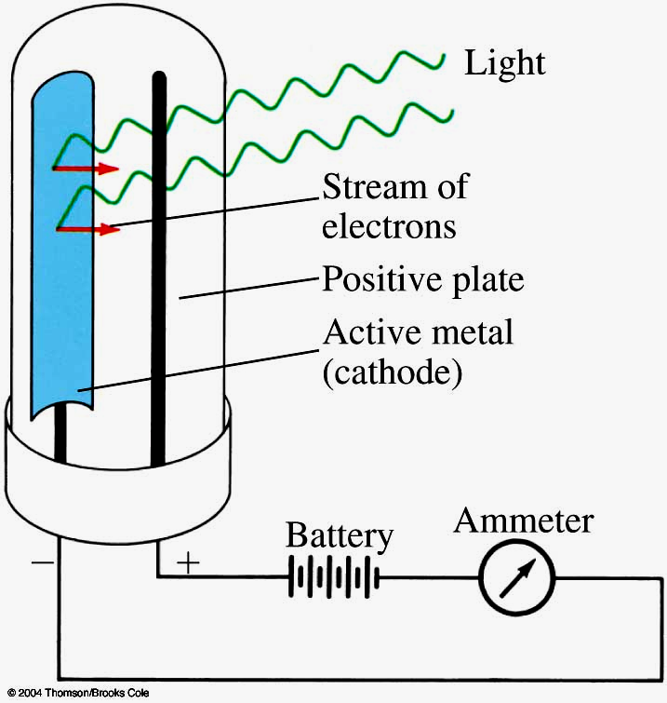
The Photoelectric Effect
Light can strike the surface of some metals causing an electron to be ejected.

Slide 46
The Photoelectric Effect
What are some practical uses of the photoelectric effect?
  You do it!
Electronic door openers
Light switches for street lights
Exposure meters for cameras
Albert Einstein explained the photoelectric effect
  Explanation involved light having particle-like behavior.
  Einstein won the 1921 Nobel Prize in Physics for this work.

Slide 47
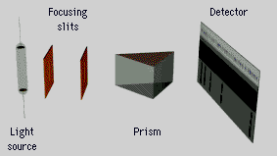
Atomic Spectra and the Bohr Atom
An emission spectrum is formed by an electric current passing through a gas in a vacuum tube (at very low pressure) which causes the gas to emit light.
  Sometimes called a bright line spectrum.

Slide 48
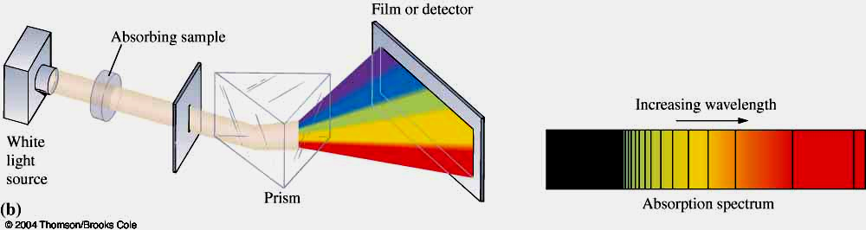
Atomic Spectra and the Bohr Atom
An absorption spectrum is formed by shining a beam of white light through a sample of gas.
  Absorption spectra indicate the wavelengths of light that have been absorbed.

Slide 49
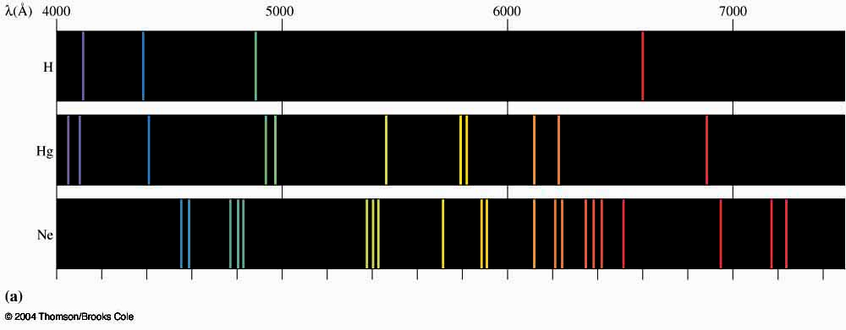
Atomic Spectra and the Bohr Atom
Every element has a unique spectrum.
Thus we can use spectra to identify elements.
  This can be done in the lab, stars, fireworks, etc.

Slide 50
Atomic Spectra and the Bohr Atom
Atomic and molecular spectra are important indicators of the underlying structure of the species.
In the early 20th century several eminent scientists began to understand this underlying structure.
  Included in this list are:
  Niels Bohr
  Erwin Schrodinger
  Werner Heisenberg

Slide 51
Atomic Spectra and the Bohr Atom
Example 5-7: An orange line of wavelength 5890 Å is observed in the emission spectrum of sodium. What is the energy of one photon of this orange light?
  You do it!

Slide 52
Atomic Spectra and the Bohr Atom
The Rydberg equation is an empirical equation that relates the wavelengths of the lines in the hydrogen spectrum.

Slide 53
Atomic Spectra and the Bohr Atom
Example 5-8. What is the wavelength of light emitted when the hydrogen atom’s energy changes from n = 4 to n = 2?

Slide 54
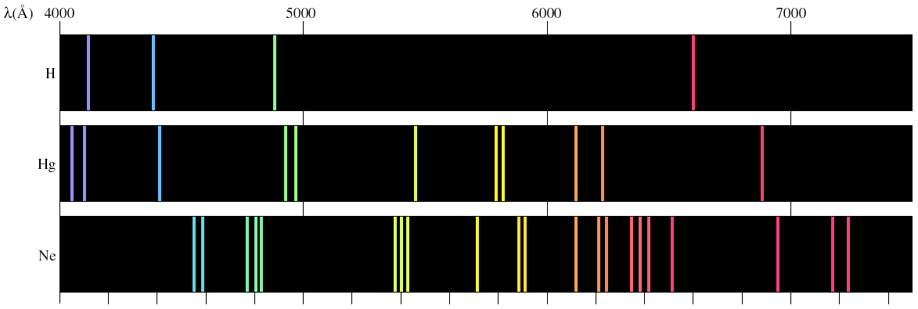
Atomic Spectra and the Bohr Atom
Notice that the wavelength calculated from
the Rydberg equation matches the wavelength
of the green colored line in the H spectrum.

Slide 55
Atomic Spectra and the Bohr Atom
In 1913 Neils Bohr incorporated Planck’s quantum theory into the hydrogen spectrum explanation.
Here are the postulates of Bohr’s theory.
Atom has a number of definite and discrete energy levels (orbits) in which an electron may exist without emitting or absorbing electromagnetic radiation.
    As the orbital radius increases so does the energy
    1<2<3<4<5......

Slide 56
Atomic Spectra and the Bohr Atom
An electron may move from one discrete energy level (orbit) to another, but, in so doing, monochromatic radiation is emitted or absorbed in accordance with the following equation.
    Energy is absorbed when electrons jump to higher orbits.
    n = 2 to n = 4 for example
    Energy is emitted when electrons fall to lower orbits.
      n = 4 to n = 1 for example

Slide 57
Atomic Spectra and the Bohr Atom
An electron moves in a circular orbit about the nucleus and it motion is governed by the ordinary laws of mechanics and electrostatics, with the restriction that the angular momentum of the electron is quantized (can only have certain discrete values).
    angular momentum = mvr = nh/2π
    h = Planck’s constant n = 1,2,3,4,...(energy levels)
    v = velocity of electron m = mass of electron
    r = radius of orbit

Slide 58
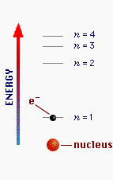
Atomic Spectra and the Bohr Atom
Light of a characteristic wavelength (and frequency) is emitted when electrons move from higher E (orbit, n = 4) to lower E (orbit, n = 1).
  This is the origin of emission spectra.
Light of a characteristic wavelength (and frequency) is absorbed when electron jumps from lower E (orbit, n = 2) to higher E (orbit, n= 4)
  This is the origin of absorption spectra.

Slide 59
Atomic Spectra and the Bohr Atom
Bohr’s theory correctly explains the H emission spectrum.
The theory fails for all other elements because it is not an adequate theory.

Slide 60
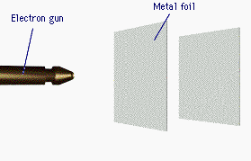

The Wave Nature of the Electron
In 1925 Louis de Broglie published his Ph.D. dissertation.
  A crucial element of his dissertation is that electrons have wave-like properties.
  The electron wavelengths are described by the de Broglie relationship.

Slide 61
The Wave Nature of the Electron
De Broglie’s assertion was verified by Davisson & Germer within two years.
Consequently, we now know that electrons (in fact - all particles) have both a particle and a wave like character.
  This wave-particle duality is a fundamental property of submicroscopic particles.

Slide 62
The Wave Nature of the Electron
Example 5-9. Determine the wavelength, in m, of an electron, with mass 9.11 x 10⁻³¹ kg, having a velocity of 5.65 x 10⁷ m/s.
  Remember Planck’s constant is 6.626 x 10⁻³⁴ Js which is also equal to 6.626 x 10⁻³⁴ kg m²/s².

Slide 63
The Wave Nature of the Electron
Example 5-10. Determine the wavelength, in m, of a 0.22 caliber bullet, with mass 3.89 x 10⁻³ kg, having a velocity of 395 m/s, ~ 1300 ft/s.
You do it!
Why is the bullet’s wavelength so small compared to the electron’s wavelength?

Slide 64
The Quantum Mechanical
Picture of the Atom
Werner Heisenberg in 1927 developed the concept of the Uncertainty Principle.
It is impossible to determine simultaneously both the position and momentum of an electron (or any other small particle).
  Detecting an electron requires the use of electromagnetic radiation which displaces the electron!
    Electron microscopes use this phenomenon

Slide 65
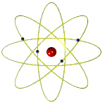

The Quantum Mechanical
Picture of the Atom
Consequently, we must must speak of the electrons’ position about the atom in terms of probability functions.
These probability functions are represented as orbitals in quantum mechanics.

Slide 66
The Quantum Mechanical
Picture of the Atom
Basic Postulates of Quantum Theory
Atoms and molecules can exist only in certain energy states. In each energy state, the atom or molecule has a definite energy. When an atom or molecule changes its energy state, it must emit or absorb just enough energy to bring it to the new energy state (the quantum condition).

Slide 67
The Quantum Mechanical
Picture of the Atom
Atoms or molecules emit or absorb radiation (light) as they change their energies. The frequency of the light emitted or absorbed is related to the energy change by a simple equation.

Slide 68
The Quantum Mechanical
Picture of the Atom
The allowed energy states of atoms and molecules can be described by sets of numbers called quantum numbers.
Quantum numbers are the solutions of the Schrodinger, Heisenberg & Dirac equations.
Four quantum numbers are necessary to describe energy states of electrons in atoms.

Slide 69
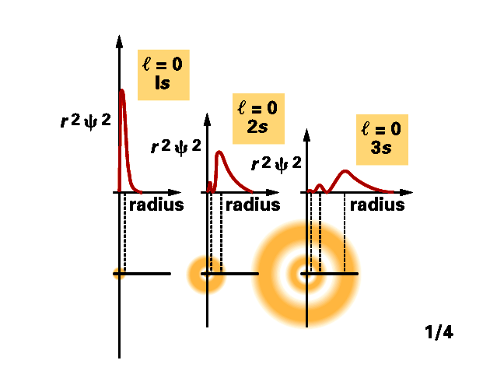
Quantum Numbers
The principal quantum number has the symbol – n.
    n = 1, 2, 3, 4, ...... “shells”
    n = K, L, M, N, ......
    The electron’s energy depends principally on n .

Slide 70
Quantum Numbers
The angular momentum quantum number has the symbol .
  ● = 0, 1, 2, 3, 4, 5, .......(n-1)
  ● = s, p, d, f, g, h, .......(n-1)
● tells us the shape of the orbitals.
These orbitals are the volume around the atom that the electrons occupy 90-95% of the time.
  This is one of the places where Heisenberg’s Uncertainty principle comes into play.

Slide 71
Quantum Numbers
The symbol for the magnetic quantum number is m.
  m = -  , (-  + 1), (-  +2), .....0, ......., ( -2), ( -1), 
If  = 0 (or an s orbital), then m = 0.
  Notice that there is only 1 value of m.
    This implies that there is one s orbital per n value. n ≥ 1
If  = 1 (or a p orbital), then m = -1,0,+1.
  There are 3 values of m.
    Thus there are three p orbitals per n value. n ≥ 2

Slide 72
Quantum Numbers
If  = 2 (or a d orbital), then m = -2,-1,0,+1,+2.
  There are 5 values of m.
    Thus there are five d orbitals per n value. n ≥ 3
If  = 3 (or an f orbital), then m = -3,-2,-1,0,+1,+2, +3.
  There are 7 values of m.
    Thus there are seven f orbitals per n value, n
Theoretically, this series continues on to g,h,i, etc. orbitals.
  Practically speaking atoms that have been discovered or made up to this point in time only have electrons in s, p, d, or f orbitals in their ground state configurations.

Slide 73
Quantum Numbers
The last quantum number is the spin quantum number which has the symbol m_{s}.
The spin quantum number only has two possible values.
  m_{s} = +1/2 or -1/2
  m_{s} = ± 1/2
This quantum number tells us the spin and orientation of the magnetic field of the electrons.
Wolfgang Pauli in 1925 discovered the Exclusion Principle.
  No two electrons in an atom can have the same set of 4 quantum numbers.

Slide 74
Atomic Orbitals
Atomic orbitals are regions of space where the probability of finding an electron about an atom is highest.
s orbital properties:
  There is one s orbital per n level.
  ● = 0 1 value of m

Slide 75
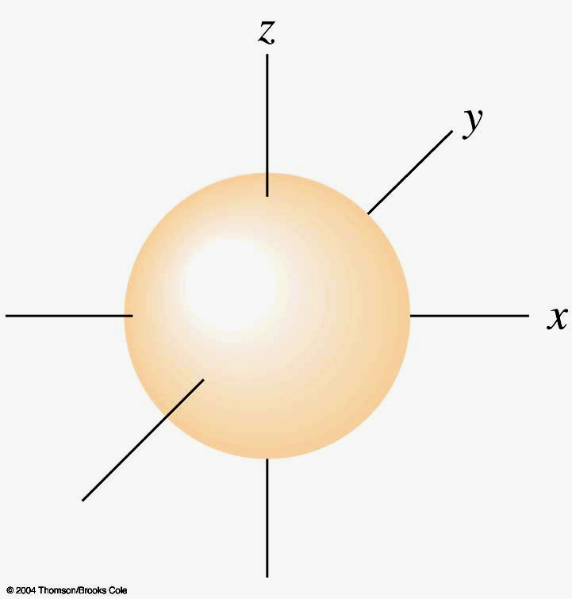
Atomic Orbitals
s orbitals are spherically symmetric.

Slide 76
Atomic Orbitals
p orbital properties:
  The first p orbitals appear in the n = 2 shell.
p orbitals are peanut or dumbbell shaped volumes.
  They are directed along the axes of a Cartesian coordinate system.
There are 3 p orbitals per n level.
  The three orbitals are named p_{x}, p_{y}, p_{z}.
  They have an  = 1.
  m = -1,0,+1 3 values of m

Slide 77
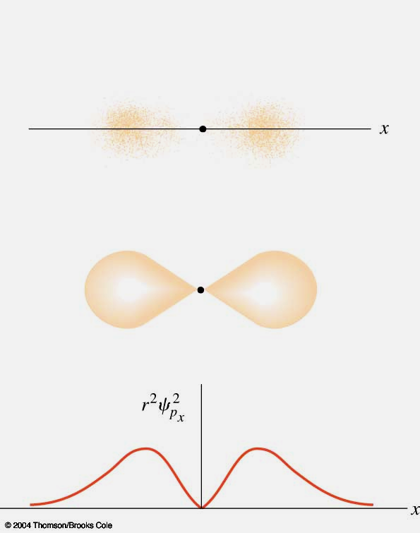
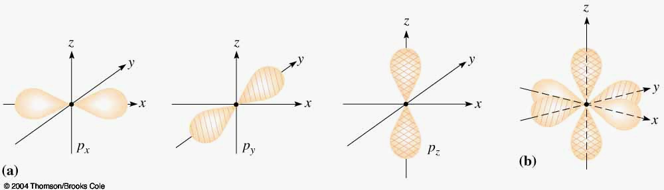
Atomic Orbitals
p orbitals are peanut or dumbbell shaped.

Slide 78
Atomic Orbitals
d orbital properties:
  The first d orbitals appear in the n = 3 shell.
The five d orbitals have two different shapes:
  4 are clover leaf shaped.
  1 is peanut shaped with a doughnut around it.
  The orbitals lie directly on the Cartesian axes or are rotated 45º from the axes.
There are 5 d orbitals per n level.
  The five orbitals are named
  They have an  = 2.
  m = -2,-1,0,+1,+2 5 values of m 

Slide 79
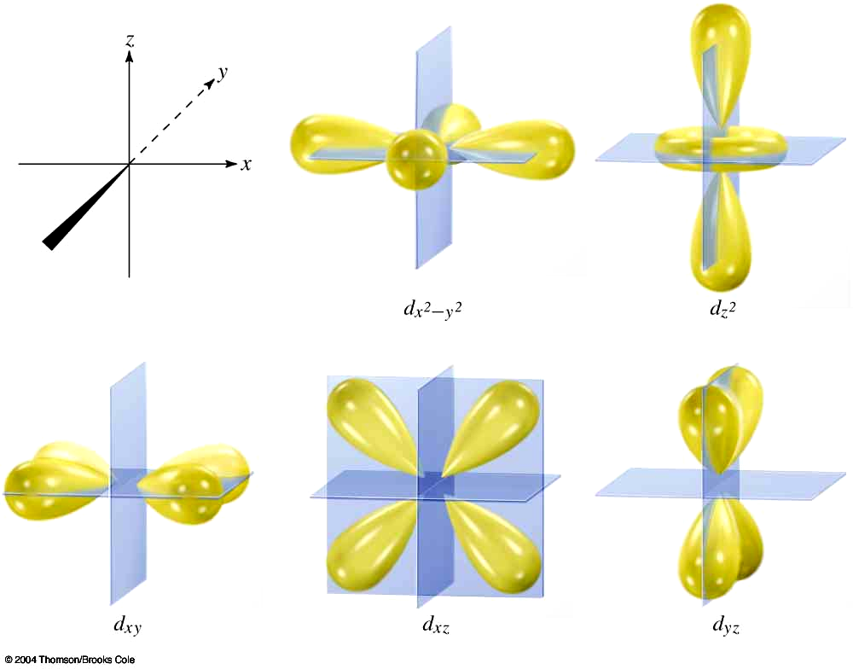
Atomic Orbitals
d orbital shapes

Slide 80
Atomic Orbitals
f orbital properties:
  The first f orbitals appear in the n = 4 shell.
The f orbitals have the most complex shapes.
There are seven f orbitals per n level.
  The f orbitals have complicated names.
  They have an  = 3
  m = -3,-2,-1,0,+1,+2, +3 7 values of m
  The f orbitals have important effects in the lanthanide and actinide elements.

Slide 81
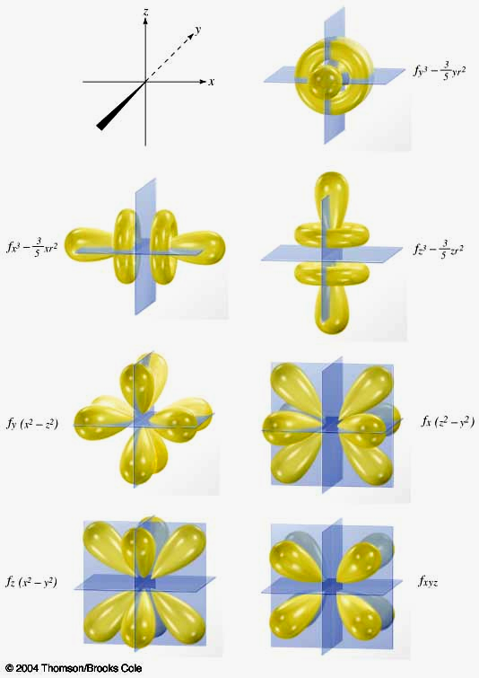
Atomic Orbitals
f orbital shapes

Slide 82
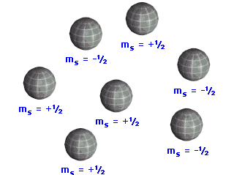
Atomic Orbitals
Spin quantum number effects:
  Every orbital can hold up to two electrons.
    Consequence of the Pauli Exclusion Principle.
  The two electrons are designated as having
  one spin up ↑ and one spin down ↓
Spin describes the direction of the electron’s magnetic fields.

Slide 83
Paramagnetism and Diamagnetism
Unpaired electrons have their spins aligned ↑↑ or ↓↓
  This increases the magnetic field of the atom.
Atoms with unpaired electrons are called paramagnetic .
  Paramagnetic atoms are attracted to a magnet.

Slide 84
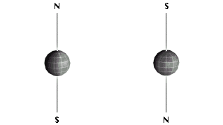
Paramagnetism and Diamagnetism
Paired electrons have their spins unaligned ↑↓.
  Paired electrons have no net magnetic field.
Atoms with unpaired electrons are called diamagnetic.
  Diamagnetic atoms are repelled by a magnet.

Slide 85
Paramagnetism and Diamagnetism
Because two electrons in the same orbital must be paired, it is possible to calculate the number of orbitals and the number of electrons in each n shell.
The number of orbitals per n level is given by n².
The maximum number of electrons per n level is 2n².
  The value is 2n² because of the two paired electrons.

Slide 86
Paramagnetism and Diamagnetism
Energy Level # of Orbitals Max. # of e⁻
n n² 2n²
1 1 2
2 4 8
You do it!
3 9 18
4 16 32

Slide 87
The Periodic Table and
Electron Configurations
The principle that describes how the periodic chart is a function of electronic configurations is the Aufbau Principle.
The electron that distinguishes an element from the previous element enters the lowest energy atomic orbital available.

Slide 88
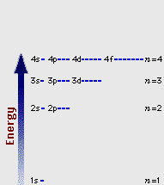
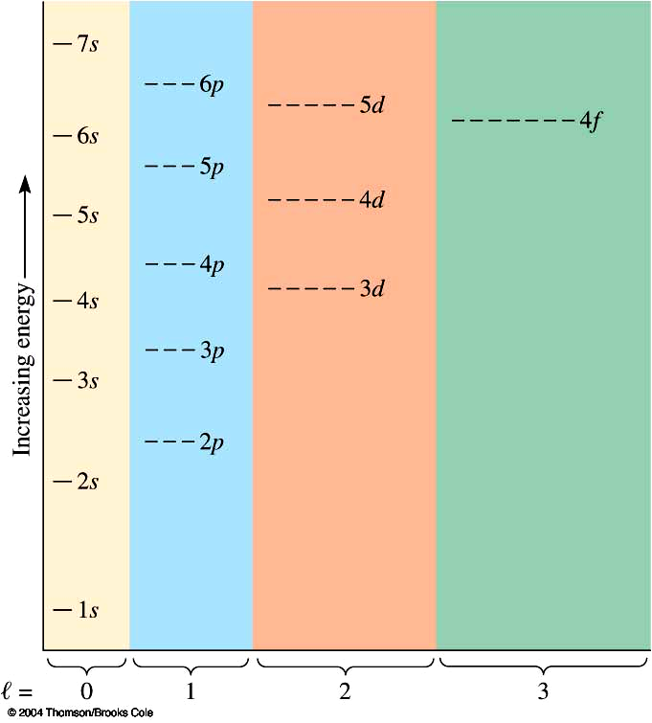
The Periodic Table and
Electron Configurations
The Aufbau Principle describes the electron filling order in atoms.

Slide 89
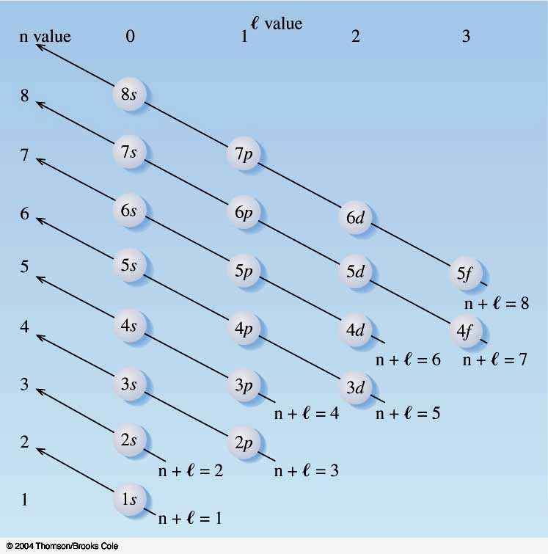
The Periodic Table and
Electron Configurations
There are two ways to remember the correct filling order for electrons in atoms.
You can use this mnemonic.

Slide 90
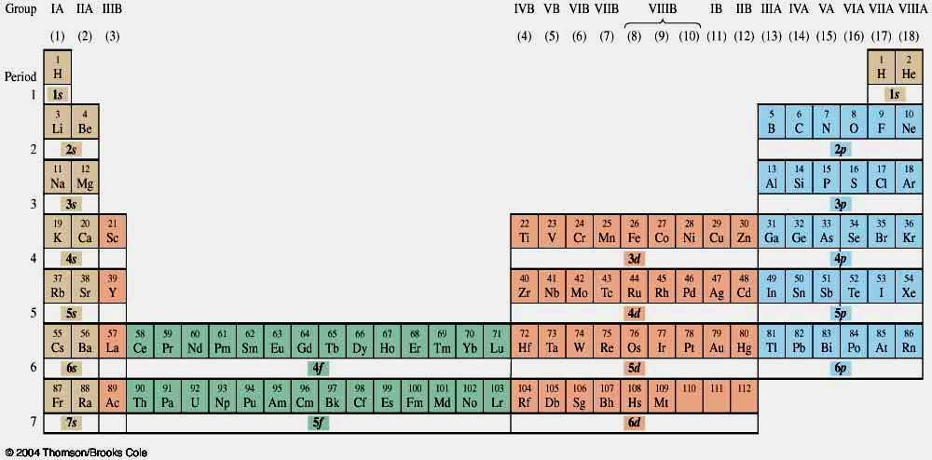
The Periodic Table and
Electron Configurations
Or you can use the periodic chart .

Slide 91
The Periodic Table and
Electron Configurations
Now we will use the Aufbau Principle to determine the electronic configurations of the elements on the periodic chart.
1st row elements.

Slide 92
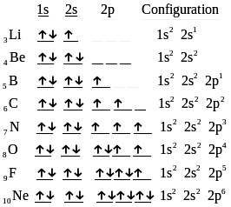
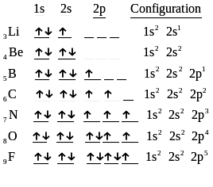
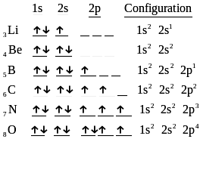
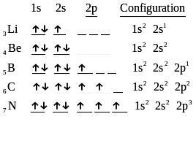
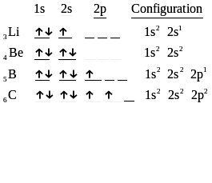
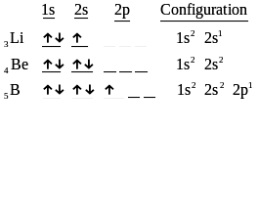
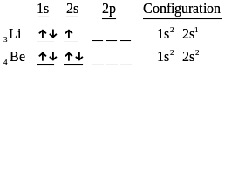
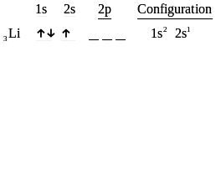
The Periodic Table and
Electron Configurations
2nd row elements.
Hund’s rule tells us that the electrons will fill the
p orbitals by placing electrons in each orbital
singly and with same spin until half-filled. Then
the electrons will pair to finish the p orbitals.

Slide 93
The Periodic Table and
Electron Configurations
3rd row elements

Slide 94
The Periodic Table and
Electron Configurations
4th row elements

Slide 95
The Periodic Table and
Electron Configurations

Slide 96
The Periodic Table and
Electron Configurations

Slide 97
The Periodic Table and
Electron Configurations

Slide 98
The Periodic Table and
Electron Configurations

Slide 99
The Periodic Table and
Electron Configurations

Slide 100
The Periodic Table and
Electron Configurations

Slide 101
The Periodic Table and
Electron Configurations

Slide 102
The Periodic Table and
Electron Configurations

Slide 103
The Periodic Table and
Electron Configurations

Slide 104
The Periodic Table and
Electron Configurations

Slide 105
The Periodic Table and
Electron Configurations

Slide 106
The Periodic Table and
Electron Configurations

Slide 107
The Periodic Table and
Electron Configurations

Slide 108
The Periodic Table and
Electron Configurations

Slide 109
The Periodic Table and
Electron Configurations

Slide 110
The Periodic Table and
Electron Configurations

Slide 111
The Periodic Table and
Electron Configurations

Slide 112
The Periodic Table and
Electron Configurations

Slide 113
The Periodic Table and
Electron Configurations

Slide 114
The Periodic Table and
Electron Configurations

Slide 115
The Periodic Table and
Electron Configurations

Slide 116
The Periodic Table and
Electron Configurations

Slide 117
The Periodic Table and
Electron Configurations

Slide 118
The Periodic Table and
Electron Configurations
Now we can write a complete set of quantum numbers for all of the electrons in these three elements as examples.
  Na
  Ca
  Fe
First for ₁₁Na.
  When completed there must be one set of 4 quantum numbers for each of the 11 electrons in Na
  (remember Ne has 10 electrons)

Slide 119
The Periodic Table and
Electron Configurations

Slide 120
The Periodic Table and
Electron Configurations

Slide 121
The Periodic Table and
Electron Configurations

Slide 122
The Periodic Table and
Electron Configurations

Slide 123
The Periodic Table and
Electron Configurations

Slide 124
The Periodic Table and
Electron Configurations

Slide 125
The Periodic Table and
Electron Configurations

Slide 126
The Periodic Table and
Electron Configurations

Slide 127
The Periodic Table and
Electron Configurations

Slide 128
The Periodic Table and
Electron Configurations

Slide 129
The Periodic Table and
Electron Configurations

Slide 130
The Periodic Table and
Electron Configurations
Next we will do the same exercise for ₂₀Ca.
  Again, when finished we must have one set of 4 quantum numbers for each of the 20 electrons in Ca.
We represent the first 18 electrons in Ca with the symbol [Ar].

Slide 131
The Periodic Table and
Electron Configurations

Slide 132
The Periodic Table and
Electron Configurations

Slide 133
The Periodic Table and
Electron Configurations
Finally, we do the same exercise for ₂₆Fe.
  We should have one set of 4 quantum numbers for each of the 26 electrons in Fe.
To save time and space, we use the symbol [Ar] to represent the first 18 electrons in Fe

Slide 134
The Periodic Table and
Electron Configurations

Slide 135
The Periodic Table and
Electron Configurations

Slide 136
The Periodic Table and
Electron Configurations

Slide 137
The Periodic Table and
Electron Configurations

Slide 138
The Periodic Table and
Electron Configurations

Slide 139
The Periodic Table and
Electron Configurations

Slide 140
The Periodic Table and
Electron Configurations

Slide 141
The Periodic Table and
Electron Configurations

Slide 142
The Periodic Table and
Electron Configurations

Slide 143
The Periodic Table and
Electron Configurations

Slide 144
Synthesis Question
What is the atomic number of the element that should theoretically be the noble gas below Rn?
The 6 d’s are completed with element 112 and the 7p’s are completed with element 118. Thus the next noble gas (or perhaps it will be a noble liquid) should be element 118.

Slide 145
Group Question
In a universe different from ours, the laws of quantum mechanics are the same as ours with one small change. Electrons in this universe have three spin states, -1, 0, and +1, rather than the two, +1/2 and -1/2, that we have. What two elements in this universe would be the first and second noble gases? (Assume that the elements in this different universe have the same symbols as in ours.)

Slide 146
End of Chapter 5
The study of various spectra is one of the fundamental tools that chemists apply to numerous areas of their work.

